Slide 1
MARKETING CAMPAIGN – WAY FORWARD
-Nithesh R

Slide 2
OBJECTIVE
TO PREPARE AN INSIGHT ON WHAT THE DATA MEANS TO THE RESTAURANTS.
DISSECT THE RATINGS TO EXPLAIN WHATS WRONG OR CORRECT.
PRODUCE SOLUTION FOR MARKETING CAMPAIGN TO INCREASE FOOTFALL
SUGGEST IDEAS USING THE DATA TO IMPROVE CUSTOMER RATINGS.
VISUALLY REPRESENT ALL THE REQUIRED DATA.

Slide 3
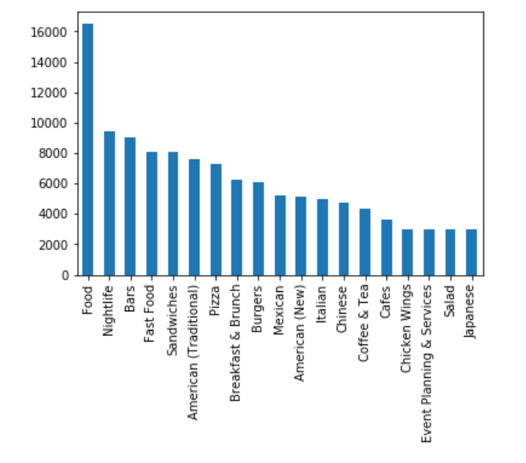
Prioritising categories
ALTHOUGH THE FIRST FEW HAVE HIGH HITS, IT IS GENERIC IN NATURE.
WE SKIP THAT TO GIVE IMPORTANCE TO TWO OF THE CATEGORIES THAT NEEDS AN EFFECTIVE CAMPAIGN TO INCREASE FOOTFALL
WE HAVE FINALIZED PIZZA AND BURGER CATEGORIES WHICH STANDS IN THE MIDDLE OF OUR FILTERED GRAPH

Slide 4
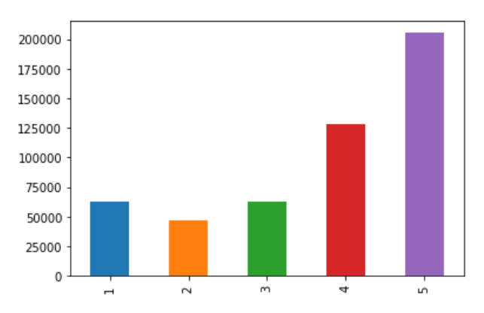
DISTRIBUTION OF RATINGS
THE DISTRIBUTION OF RATINGS WILL HELP US GET AN IDEA ON WHAT KEYWORDS CAN BE CHOSEN TO HIGHLIGHT IN OUR CAMPAIGN.
GOOD RATINGS – 5 STAR
BAD RATINGS – 4 AND BELOW
WE HAVE IDENTIFIED FEW KEYWORDS IN THESE GOOD AND BAD RATINGS WHICH CAN BE USED TO MAKE AN ATTRACTIVE POSTER TO ADVERTISE.

Slide 5
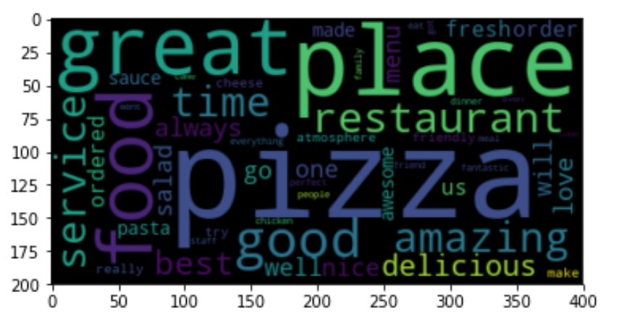
GOOD RATINGS
KEYWORDS TAKEN FROM THE GOOD RATINGS HAVE BEEN FORMED AS AN ATTRACTIVE POSTER.
THIS CAN BE USED IN ADVERTISEMENT CAMPAIGNS TO LURE CUSTOMERS AND IN INCREASING FOOTFALL FOR THE CHOSEN CATEGORIES.
THESE WORDS MIGHT SOUND POSITIVE TO CUSTOMERS MAKING AN IMPACT TO COME FOR IT.

Slide 6
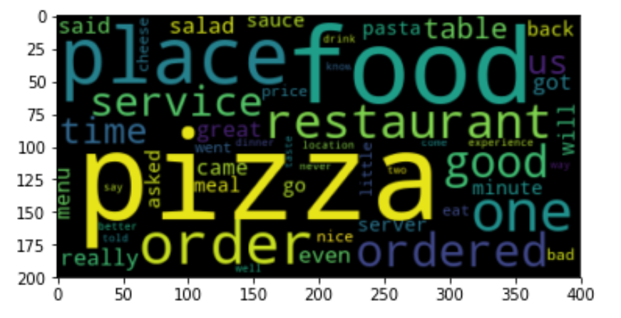
BAD RATINGS
BAD RATINGS ARE ALSO EQUALLY IMPORTANT IN GAINING CUSTOMERS BY USING IT AS A FEEDBACK.
THIS POSTER CAN BE PUT UP IN THE KITCHEN AREA OF THE RESTAURANT WHICH WILL URGE EMPLOYEES TO TAKE DUE CARE ON THE POINTS HIGHLIGHTED IN THE POSTER.
THERE MAY BE SIMIARITIES IN THE GOOD AND BAD POSTER WHICH SHOWS THAT THERE IS STILL ROOM FOR IMPROVEMENT IN MOST THINGS ABOUT THE RESTAURANT.
MANAGEMENT CAN FORM TRAINING PROGRAMS TO IMPROVE FEW ITEMS HIGHLIGHTED IN THE POSTER WHICH WILL ALSO ADD VALUE.

